Slide 1
A memristive machine learning processor
23/06/2021
By: Tej Sanghavi
Supervisor: Dr Christos Papavassiliou
2nd Marker: Dr Timothy Constandinou
1

Slide 2
Introduction and background
A memristive machine learning processor
2

Slide 3
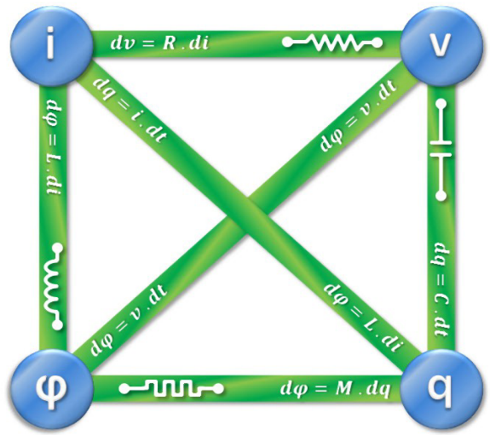

What is a memristor?
A memristive machine learning processor
For a charge controlled memristor
$φ = f\left(q\right)$
Differentiating $\frac{dφ}{dt} = \frac{df\left(q\right)}{dq}⋅\frac{dq}{dt}$
$v\left(t\right)=M\left(q\right)i\left(t\right)$
$M\left(q\right)$is the memristance, $Ω$
3
Notes:
Memristor is a portmanteau of memory+resistor.
Memristors are passive, two terminal non-voltatile devices that have a charge-flux relationship that allows their resistive state RS to be modulated.

Slide 4
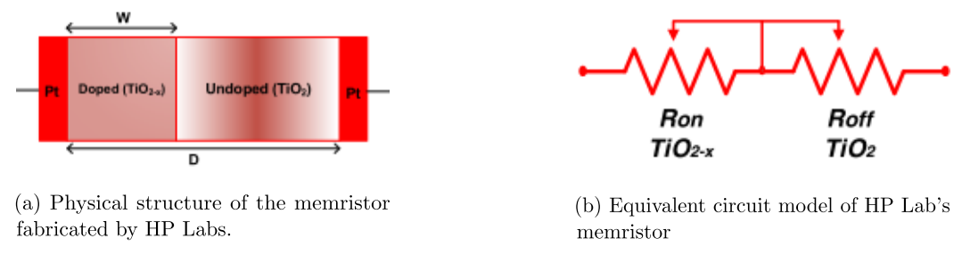

Memristor models
A memristive machine learning processor
Mathematically, the device can be modelled as:
$v\left(t\right)=\left(R_{on}\frac{w\left(t\right)}{D}+R_{off}\left(1−\frac{w\left(t\right)}{D}\right)\right)i\left(t\right)$
$\frac{d\left(w\left(t\right)\right)}{dt} = μ_{v}\frac{R_{on}}{D^{2}}i\left(t\right)$
4
Notes:
A simple model consisting of a high-resistance resistor in series with a low resistance resistor can explain their behaviour.
When a voltage is applied in one direction the barrier shifts to the right increasing the area of the low resistance resistor and when a voltage is applied in the other direction the barrier shifts to the left increasing the area occupied by the high resistance resistor.

Slide 5
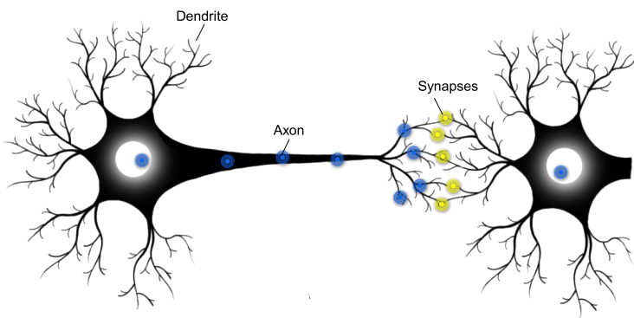
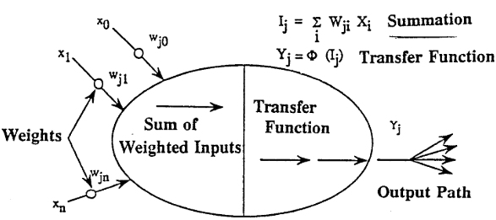
Memristors and neuromorphic engineering
A memristive machine learning processor
Brain:
3.6x10¹⁵ operations per sec at 12W.
3x10¹⁴ operations per Joule.
Efficient computation.
Millions of neurons interlinked.
Slow and Noisy components.
Digital Microprocessor:
255x10⁶ floating point operations per second at 40W.
6.25x10⁶ operations per joule.
An illustration of two connected neurons.
Schematic Representation of an Artificial Neuron
5
Notes:
Memristors have got researchers in the field of neuromorphic engineering particularly excited.
Neuromorphic engineering is an EE discipline that uses VLSI systems containing analog circuits to mimic neuro-biological architectures present in the nervous system.
This discipline was born as a solution to the bottleneck in Von Neumann computing systems where memory and and processing blocks are separated thus introducing a latency which will eventually limit the performance of such a system.
The brain on the other hand contains around 10^15 neurons interlinked, to form a highly parallel structure that’s around 7 orders of magnitude more efficient than the best uP.
Store and process info in the same location
The diagram on the RHS shows the axon of one neuron connected to the dendrite of another neuron via a synapse.
The synapse is a tiny gap that modulates the strength of a signal passed from one neuron to another by varying the amount of neurotransmitter fluid.
A neuron receives signals from several other neurons and if the sum of the signals exceeds a threshold it fires.
This is the inspiration behind ANN where the synaptic connections are represented by weights.

Slide 6
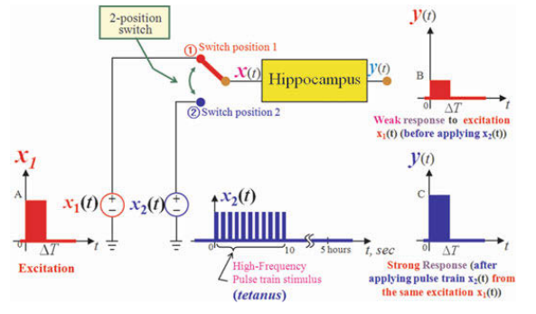
A memristive machine learning processor
Memristors are synapses!
Simplified schematic diagram depicting the classic Bliss-Lomo experimental set-up.
“When an axon of cell A is near enough to excite a cell B and repeatedly or persistently takes part in firing it, some growth process or metabolic change takes place in one or both cells such that A’s efficiency, as one of the cells firing B, is increased.” – Hebbian Learning.
6
Notes:
Thus, in a hardware implementation of an ANN the RS of a memristor can represent the weight.
Besides that memristors exhibit both long and short term plasticity which takes place in synapses and are the origins of learning.

Slide 7
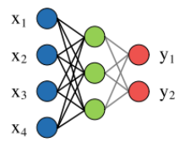
Crossbars
A memristive machine learning processor
X1
X2
X3
X4
Y1
Y1
7
Notes:
To realize the benefits of memristors typically ANN will be implemented in a crossbar array architecture which offers high density, random access and large connectivity

Slide 8
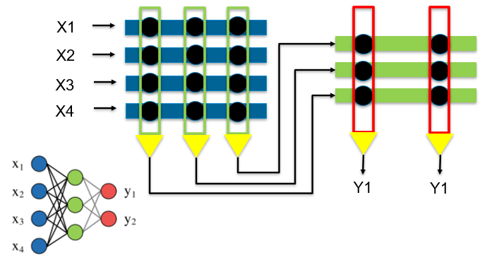

A memristive machine learning processor
Each weight, w is implemented as the conductance, G of a memristor.
The input, x is passed to the rows as a voltage, V.
Each column implements $I_{j}=\sum_{i=1}^{N}{V_{i}}⋅G_{ij}$.
Each neuron on a column implements $V_{j}=θ\left(\sum_{i=1}^{N}{V_{i}}⋅G_{ij}\right)$, where $θ$ is an activation function.
8

Slide 9
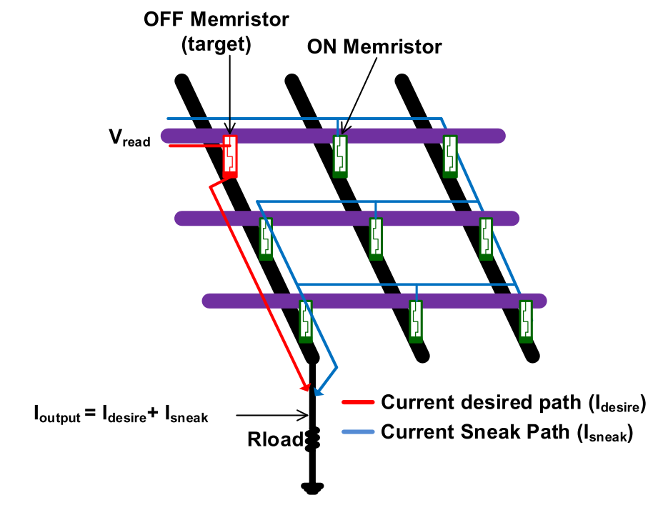
Sneak Currents
A memristive machine learning processor
Partially selected
9
Notes:
However, in practice the crossbar architecture presented usually consists of a selector device such as a MOSFET or diode to prevent sneak currents.
Sneak currents are unintended paths taken by current.
However, these selector devices limit a fully neural architecture from being realised and consume power.
The aim of my project is to show that these selectorless memristor crossbar arrays can reliably perform MAC operations and to my best knowledge this has never been researched before.

Slide 10
Implementation
A memristive machine learning processor
10

Slide 11
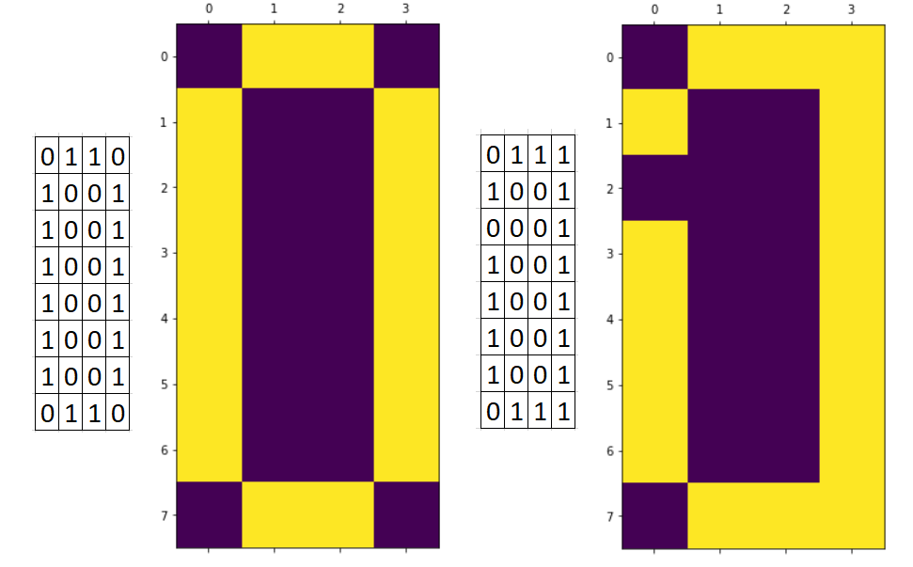
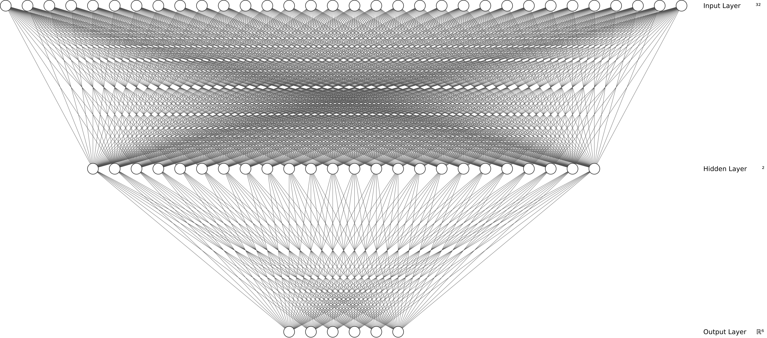
Neural network model
A memristive machine learning processor
Note:
Weights constrained between 0 and 1
11
Notes:
To demonstrate that a selectorless memristor crossbar can reliably perform these operations my project recreates a software based image classification NN created using keras.
The dataset consists of 4x8 pixel images that have 3 bit errors randomly introduced in them.
The neural network is simple; the 32 pixels are fed to a hidden layer consisting of 24 neurons and the hidden layer is connected to an output layer consisting of 6 neurons to classify 0,1,2,3,4,5
The NN was trained on a dataset of 900 shuffled images and tested on a labelled dataset of 300 images.
Note: The weights were constrained to be between 0 and 1.

Slide 12
Hardware Implementation Demo
A memristive machine learning processor
12

Slide 13
Testing and Results
A memristive machine learning processor
13

Slide 14
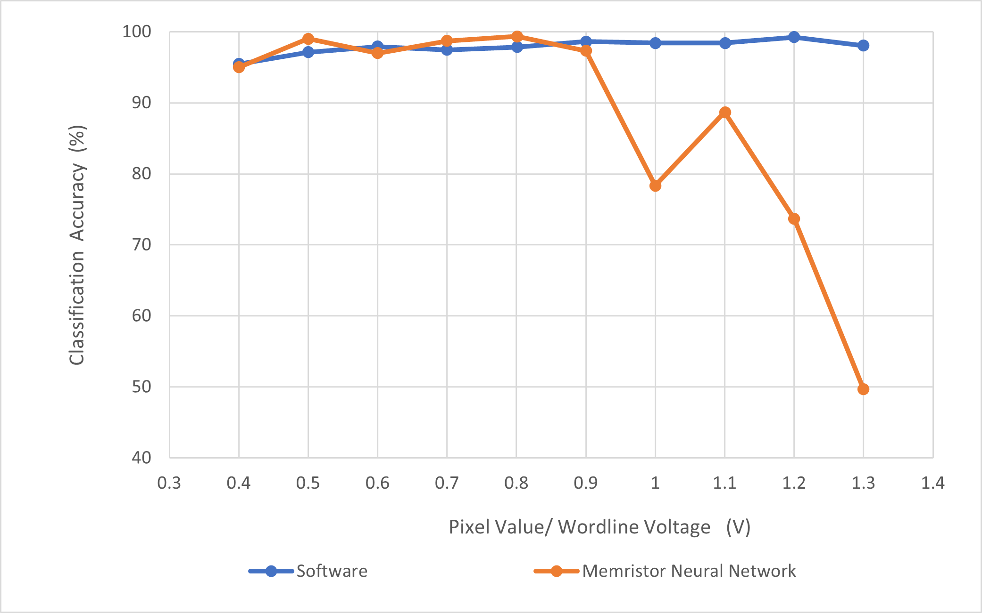
Network Inputs
A memristive machine learning processor
14
Notes:
The neural network classification accuracy was tested on various binary pixel inputs from 0.4 to 1.3 as shown in the graph.
Beyond 0.9V the memristor NN classification accuracy begins to drop as the effect of sneak currents becomes more significant on larger inputs.

Slide 15
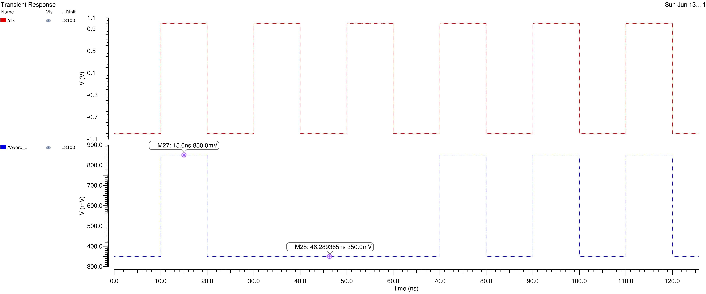
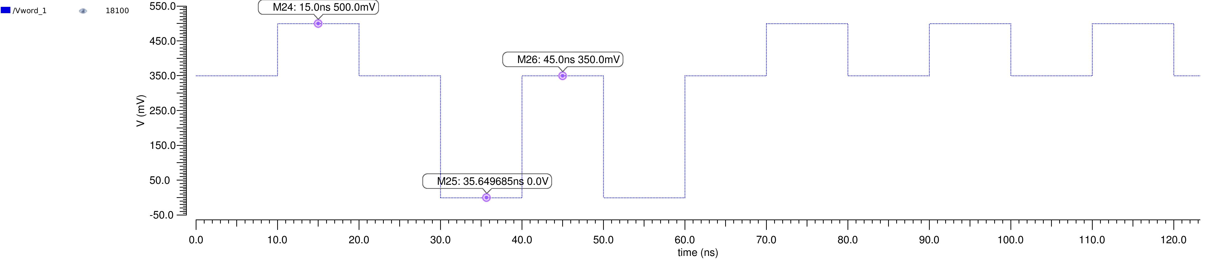
Write scheme
A memristive machine learning processor
0.35 or 0.35+X
0 or X
15
Notes:
In the software model, when a pixel has an input of 0, all the neurons that it is connected to receive no contribution since W*0 = 0.
The analogous implementation to this in a crossbar would be to set the wordline to the same volatage as the bitline - 0.35V when the input is 0. Thus, the data passed to the wordlines should be ’0.35 or 0.35+X’ rather than ’0 or X’ (where X is the on binary value).
The graph shows this for an input of 0.5V.
This was the initial method that was implemented however it resulted to lower classification accuracies

Slide 16
A memristive machine learning processor
 | Classification Accuracy (%)
Binary Pixel Value (X) | 0 or X | 0.345 or 0.35 +X
0.4 | 95 | 79.7
0.5 | 99 | 77.3
Comparing classification accuracies with or without 0.35V bias
16
Notes:
One reason that could possibly explain this and the fact that the memristor classification accuracy was higher for certain binary pixel inputs is stochastic resonance.
A phenomenon that involves adding white noise to a signal that is normally too weak to be detected by a sensor. The frequencies in the white noise corresponding to the original signal’s frequencies will resonate with each other, amplifying the original signal while not amplifying the rest of the white noise – thereby increasing the signal-to-noise ratio, which makes the original signal more prominent.
The binary pixel input is this case is the signal/pattern that needs to be detected and when passed to the crossbar directs the ’noise’ i.e sneak currents towards a particular bitline/neuron that corresponds to the image it represents.

Slide 17
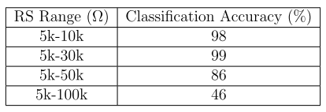
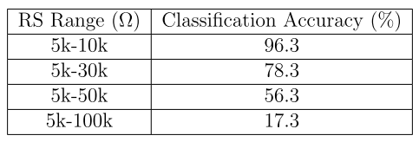
Network Weights
A memristive machine learning processor
Table showing the NN classification accuracy for different RS state ranges for a binary input of 0.5V. Note: The software classification accuracy is 97.1%.
Table showing the NN classification accuracy for different RS state ranges for a binary input of 1V. Note: The software classification accuracy is 98.4%.
17
Notes:
The gap between the orange and blue can be eliminated by finding the optimum RS range for a particular input.

Slide 18
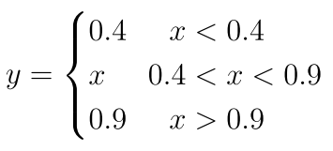
Limiting Input to restore performance
A memristive machine learning processor
The memristor NN was programmed with weights that correspond to pixel values of 1.3V but was tested with a dataset where the pixel values were limited to 0.9V. The network classification accuracy improved from 49.67% to 99.33%.
18
Notes:
However, depending on the memristors fabricated they may only exist between a particular RS range. In this case, the performance can be restored limiting the input.
For example, for a binary input of 1.3V when the weights were set toa range of 5k-30k, the classification accuracy was 49.67% as shown. But by changing the input dataset to binary pixel values of 0.9V, the performance was restored to 99.33%.

Slide 19
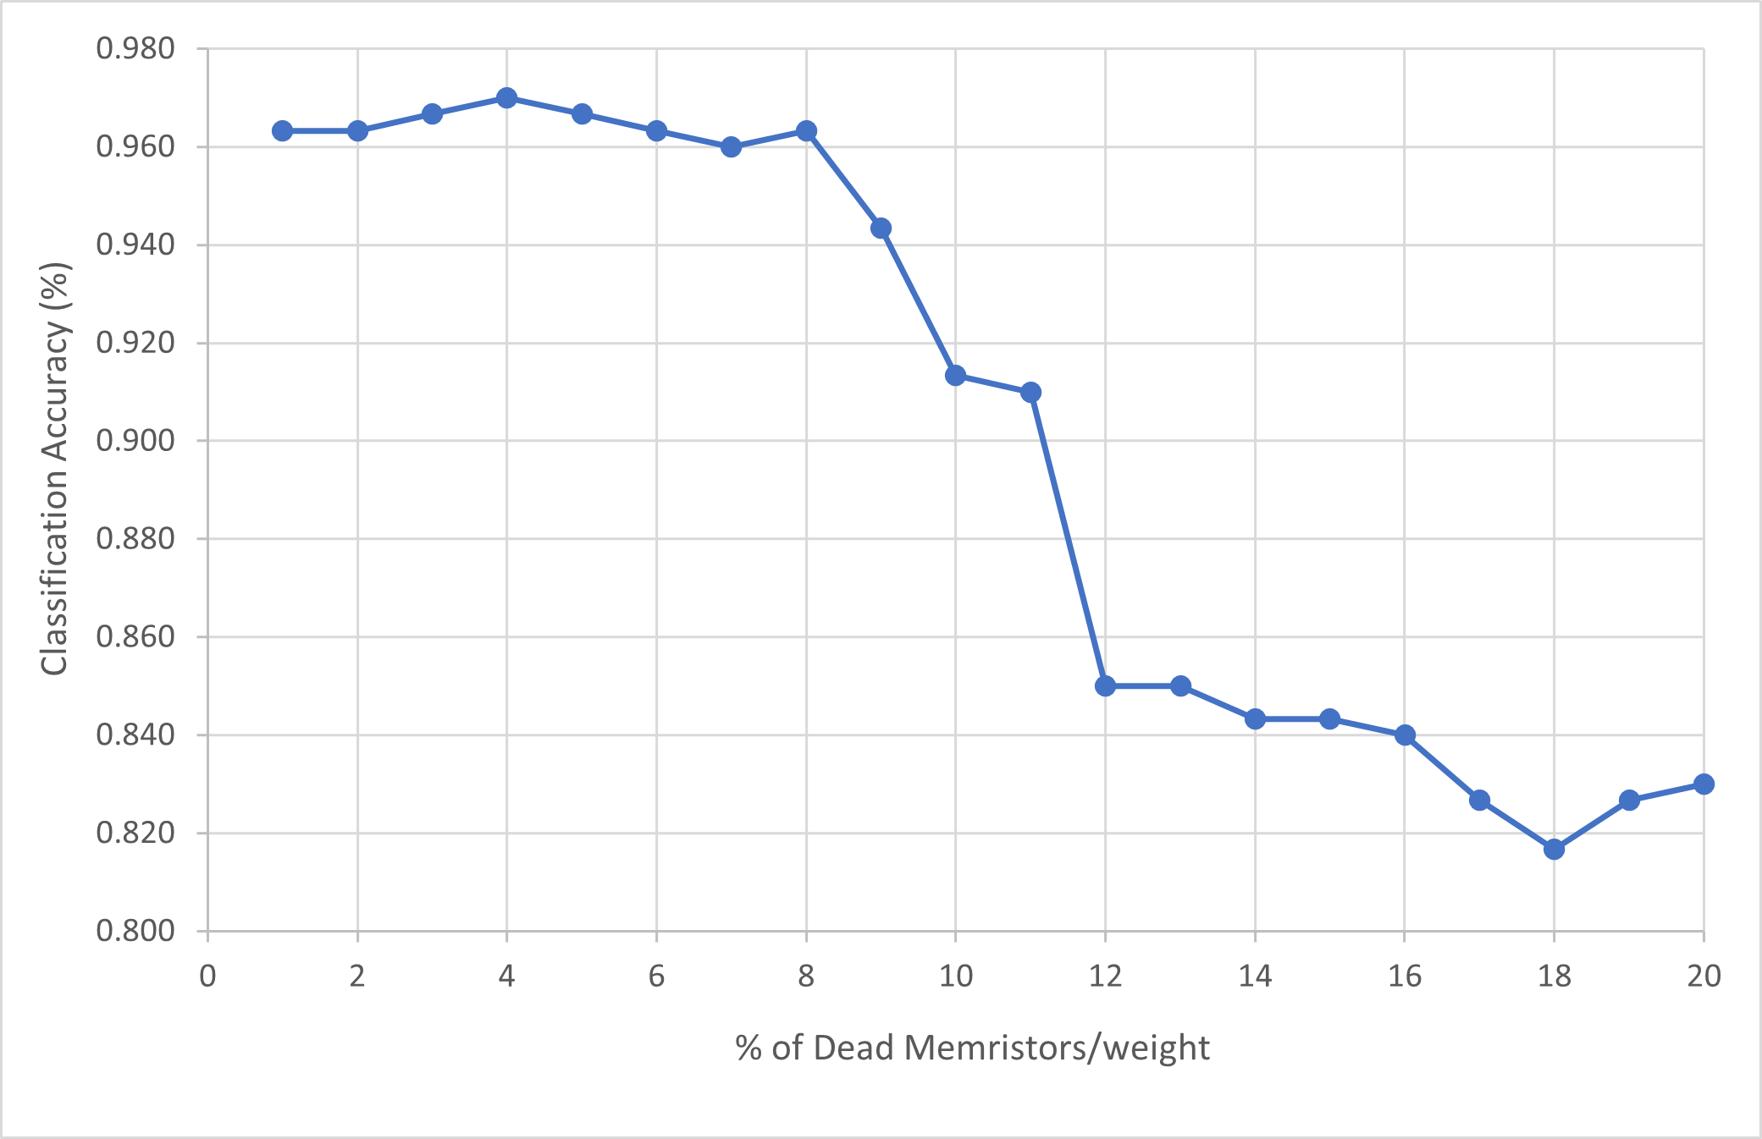
Dead Memristors
A memristive machine learning processor
19
Notes:
When fabricating large arrays of memristor crossbars a few memristors will not be functioning due to process variations and are said to be ’dead’. That is, no current can flow through them creating open circuits in the crossbar array.
To investigate whether the performance of the network can still be reliable, the memristors in the NN were first initialized as usual. A random number generator then output 10 numbers that corresponded to instances of memristors and the RS of these memristors were then set to 1GΩ and the performance of the network was then tested. The process was then repeated.
From the graph, beyond 8% of dead memristors the network classification accuracy begins to significantly decrease as the absence of MAC operations become significant to cause classification errors. Until around 8%, the network classification accuracy remains relatively constant as some MAC operations are not vital for classification i.e the current contributions to the bitlines are insignificant.
This observation is an optimization technique known as ’pruning’ in the field of machine learning where certain neurons and connections are eliminated to compress the size of models in order to reduce inference time and to allow them to run on small low power devices.

Slide 20
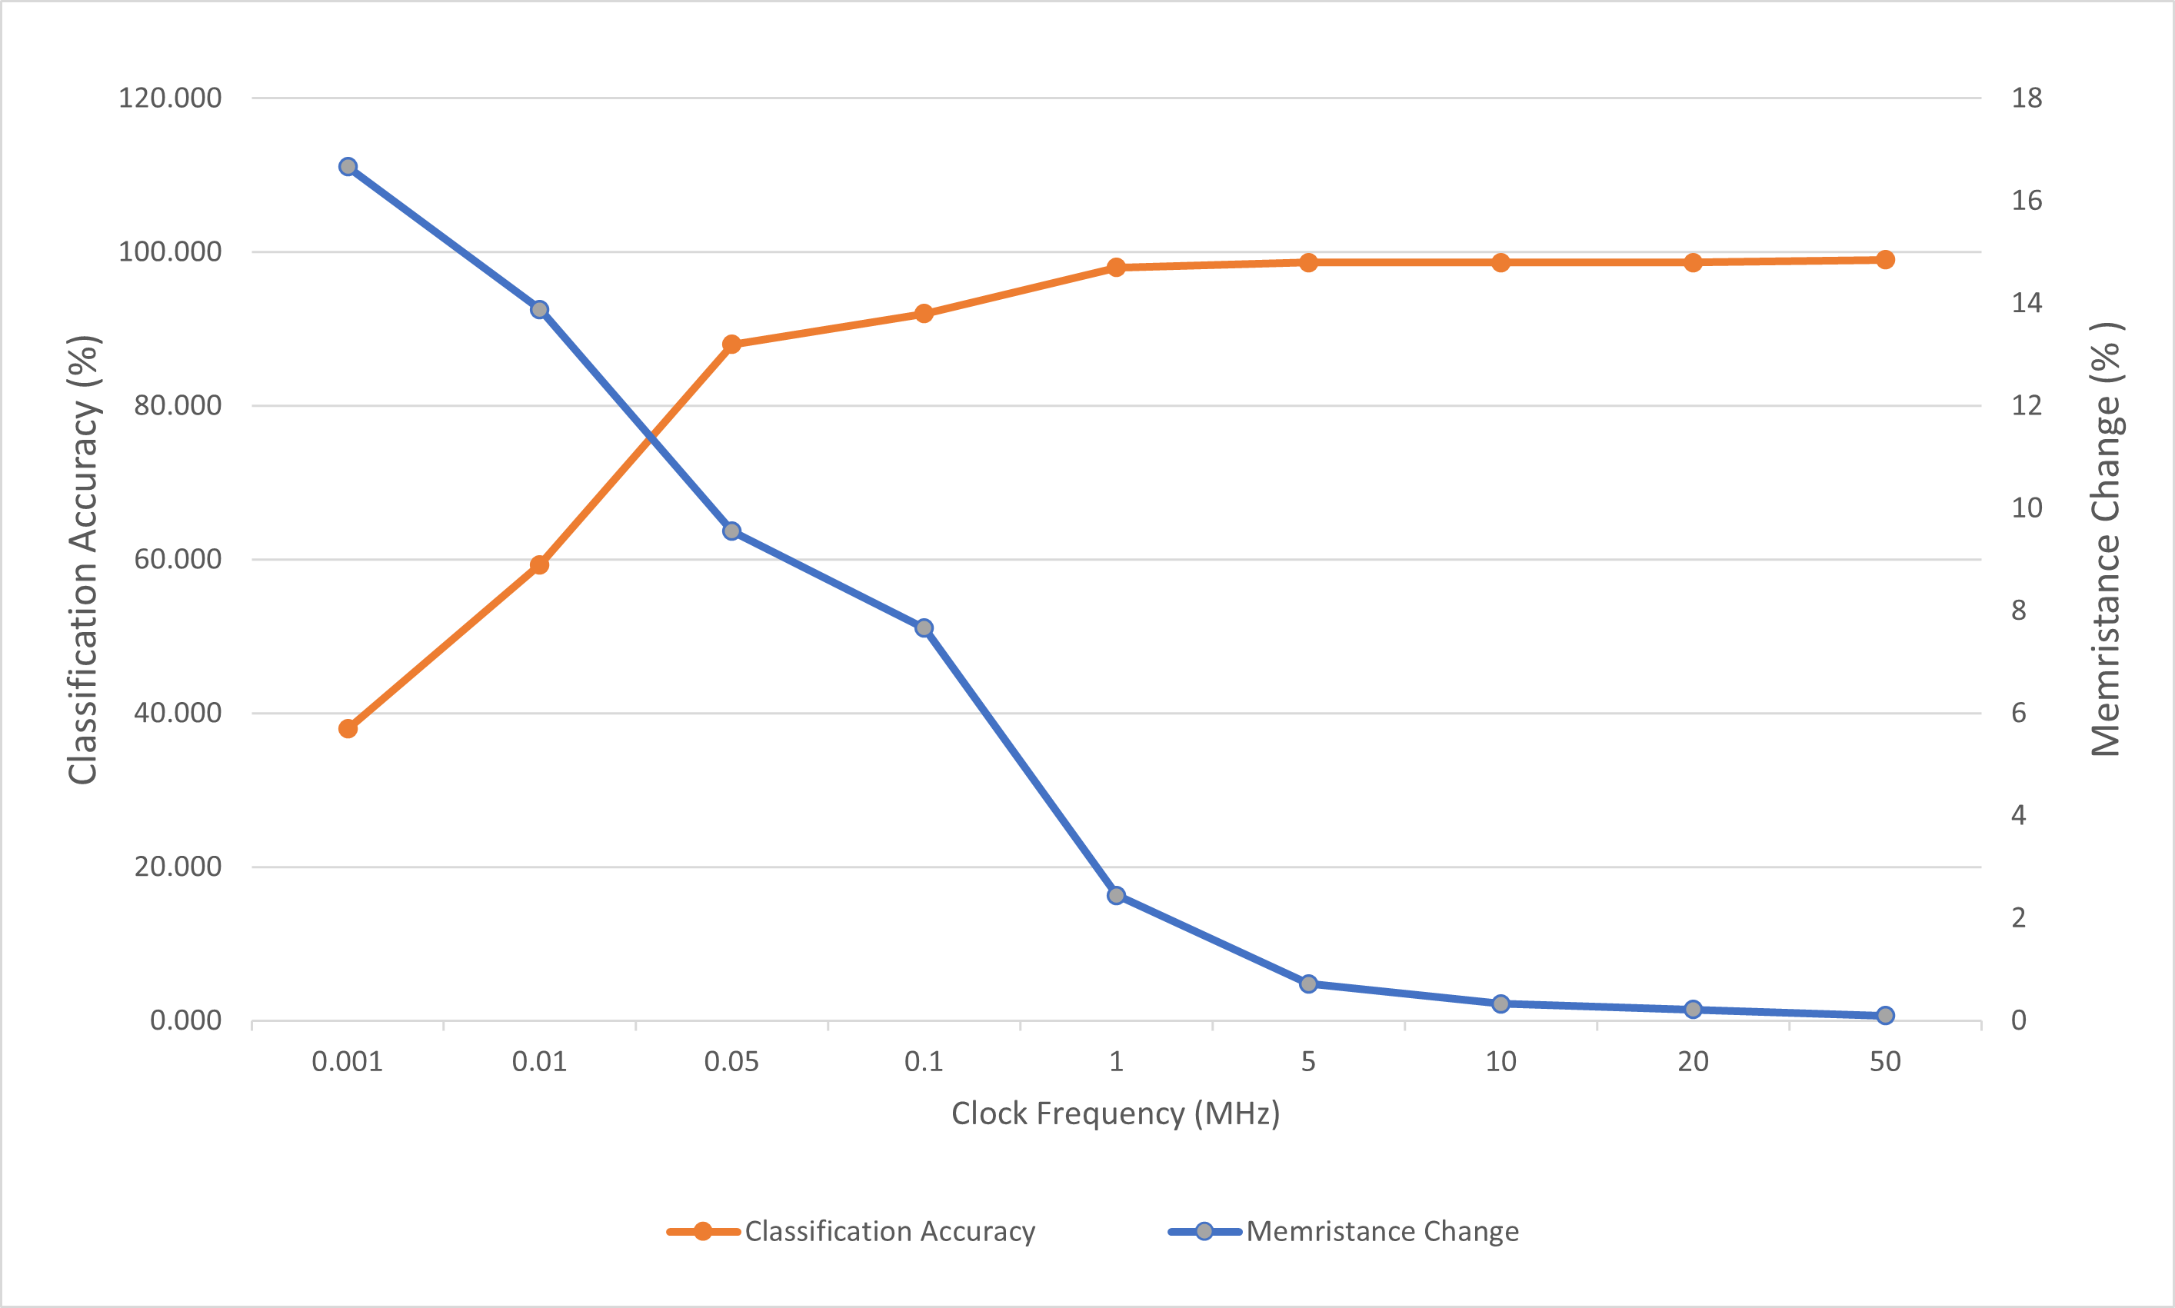
Inference Frequency
A memristive machine learning processor
20
Notes:
I then investigated the classification accuracy of the memristor NN with inference frequency.
The relationship is exponential, below 1MHz the classification accuracy rapidly decreases. This is because at low frequencies voltages are applied on the wordlines for a longer time resulting to more current flowing through the memristors causing greater changes from the initial RS the memristors were set at. The evidence of this can be seen by the exponentially decreasing blue curve which shows a particular memristors change in RS after inference has been performed on the entire data set.

Slide 21
Refreshing weights
A memristive machine learning processor
21
Notes:
The classification accuracy of a low frequency inference exercise can be restored to the same accuraccy as a high frequency inference exercise by refreshing the weights after every few test samples. From the prev dig, the classification accuracy when the entire data set was passed to the network running at 0.05MHz is 88%, however by refreshing the weights every 10 samples the classification accuracy can be increased to 97%.

Slide 22
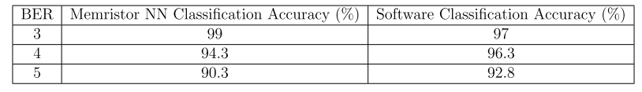
Performance on different datasets
A memristive machine learning processor
Table showing classification accuracies of the memristor NN on data sets of images with various BER.
22
Notes:
the network was also tested on a data set consisting of 4 bit errors and 5 bit errors as well to show that indeed learning did take place.

Slide 23
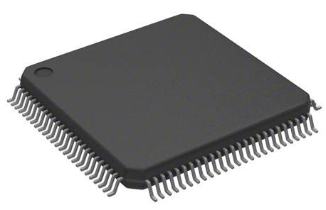
Conclusion
A memristive machine learning processor
23
Notes:
The vision of this project is to create an IC that consists of a SMC of dimension 1M X1M that is capable of implementing any neural network to perform rapid inference and learn on the go. Such an IC would revolutionise tech as it could be found in every ele device. For example, in cars to detect pedestrians
This project has not only provided experimental evidence to verify that selectorless memeristor NN crossbars can reliably perform machine learning computations, but the investigations carried out have challenged the long held notion that challenged the long held notion that sneak currents are detrimental to crossbar arrays and have provided future designers with a set of guidelines on designing an IC.

